Slide 1
Hand in your name tag (homework from last class)

Slide 2
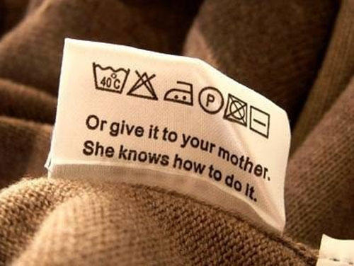
Reading Laundry Symbols

Slide 3
Sorry, your mother don’t work here…
Wash in machine with warm water
If you want to, it is ok to dry clean
DO NOT put in the dryer to tumble dry
DO NOT BLEACH
Can Iron using medium heat
Lay flat to dry naturally

Slide 4
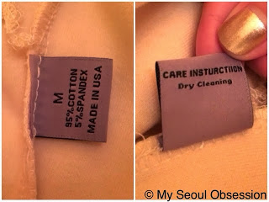
Basic info in your clothing tag
Size & brand name
Material it is made of
Where it is made
Care Instruction

Slide 5
Care Instructions can come in symbols

Slide 6
decode symbols = looking fabulous

Slide 7
Method of washing

Slide 8
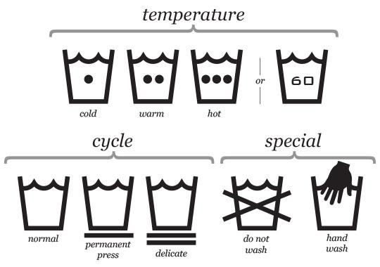

Slide 9
Can’t wash with water??? Well… you will need to send it to the professionals Dry Clean= Paying someone to do it

Slide 10
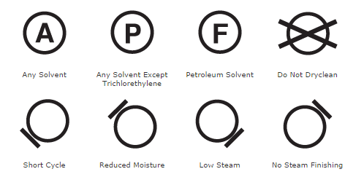
Dry Clean

Slide 11
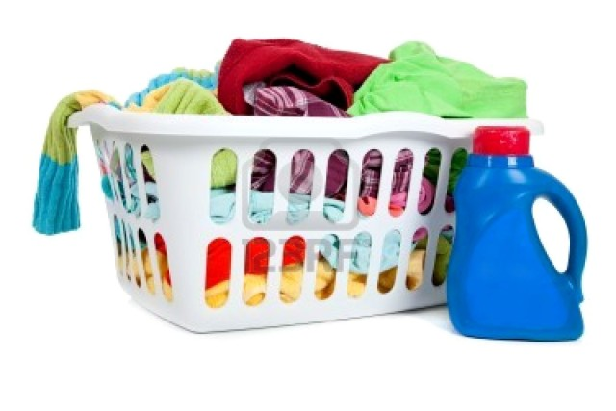

Slide 12
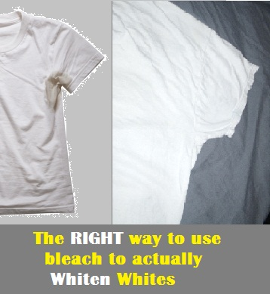
Bleach

Slide 13
using a dryer to dry

Slide 14
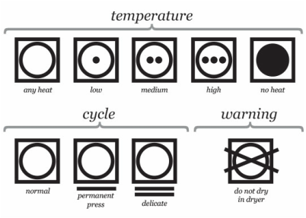

Slide 15
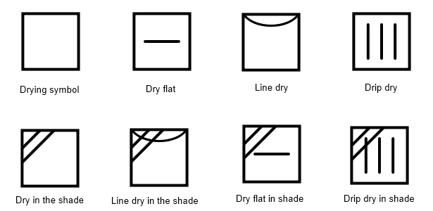
Method to Dry without dryer

Slide 16
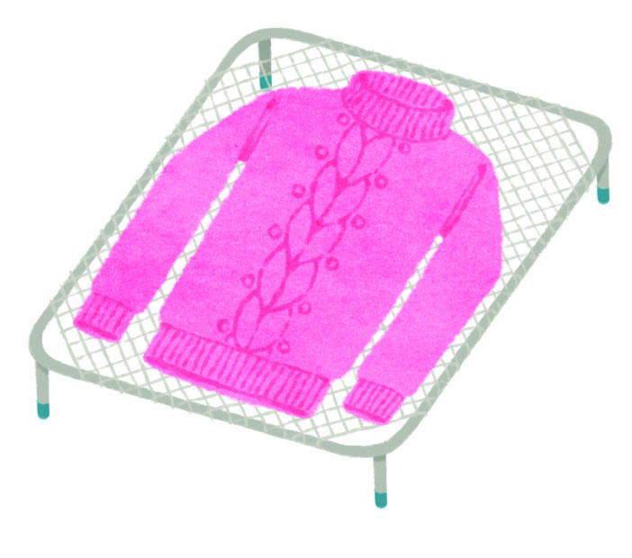
Drip Dry
Dry Flat

Slide 17
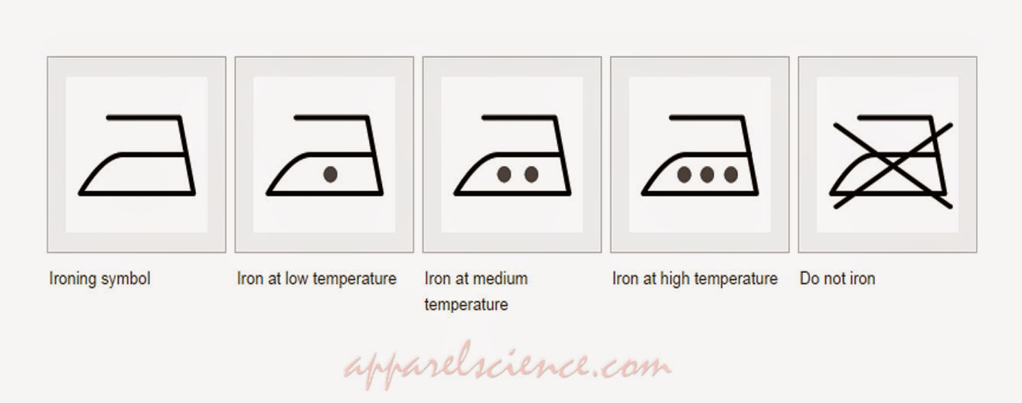
Iron

Slide 19
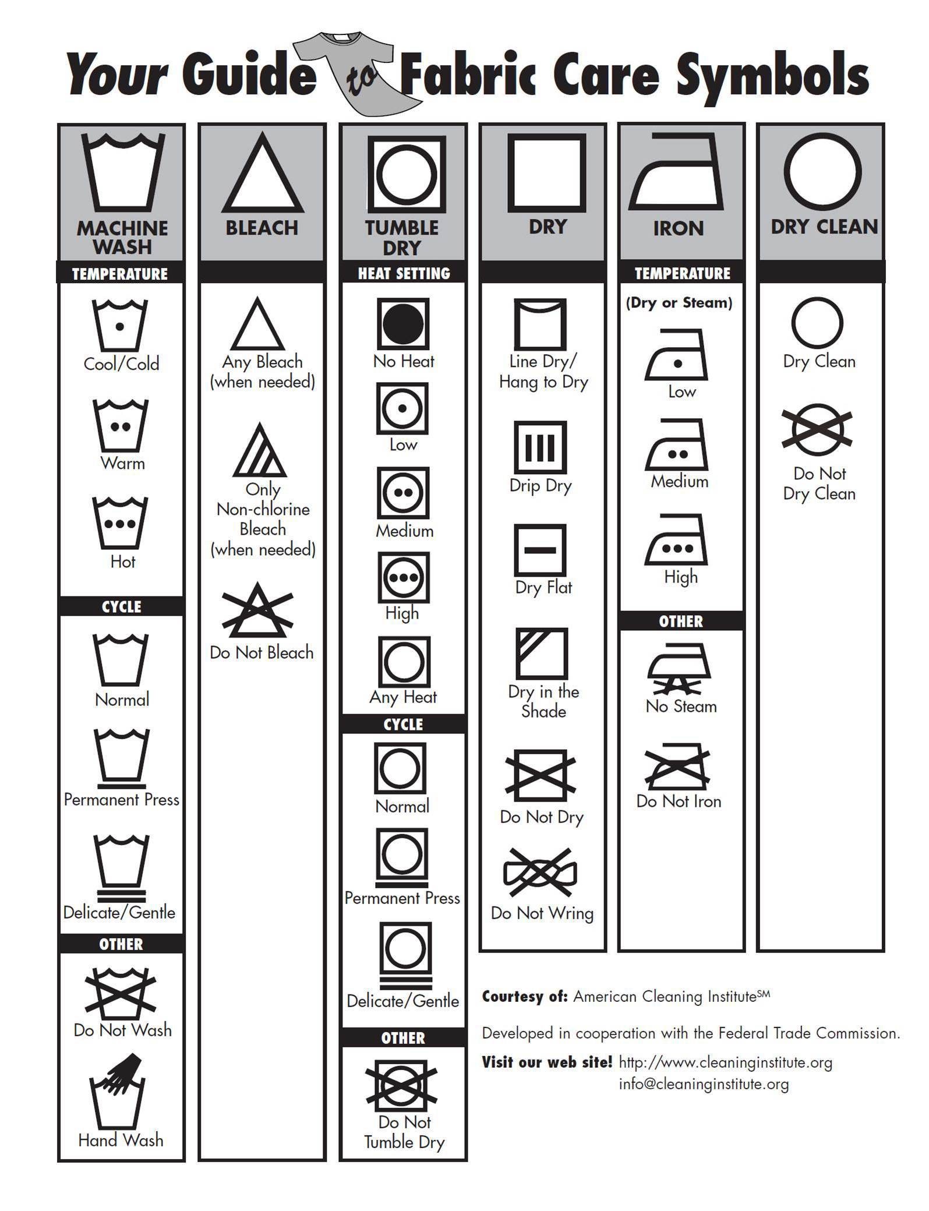

Slide 20
Check Your Knowledge…

Slide 21
Delicate wash cycle with 40 C water (warm)
No Bleach
Don’t’ put in dryer
Can iron with medium heat
Can send to dry cleaner

Slide 22
Wash in warm water (40 C)
Iron with medium heat
Do Not Bleach
Don’t send in for dry cleaning
Don’t put in the dryer to dry

