Slide 1
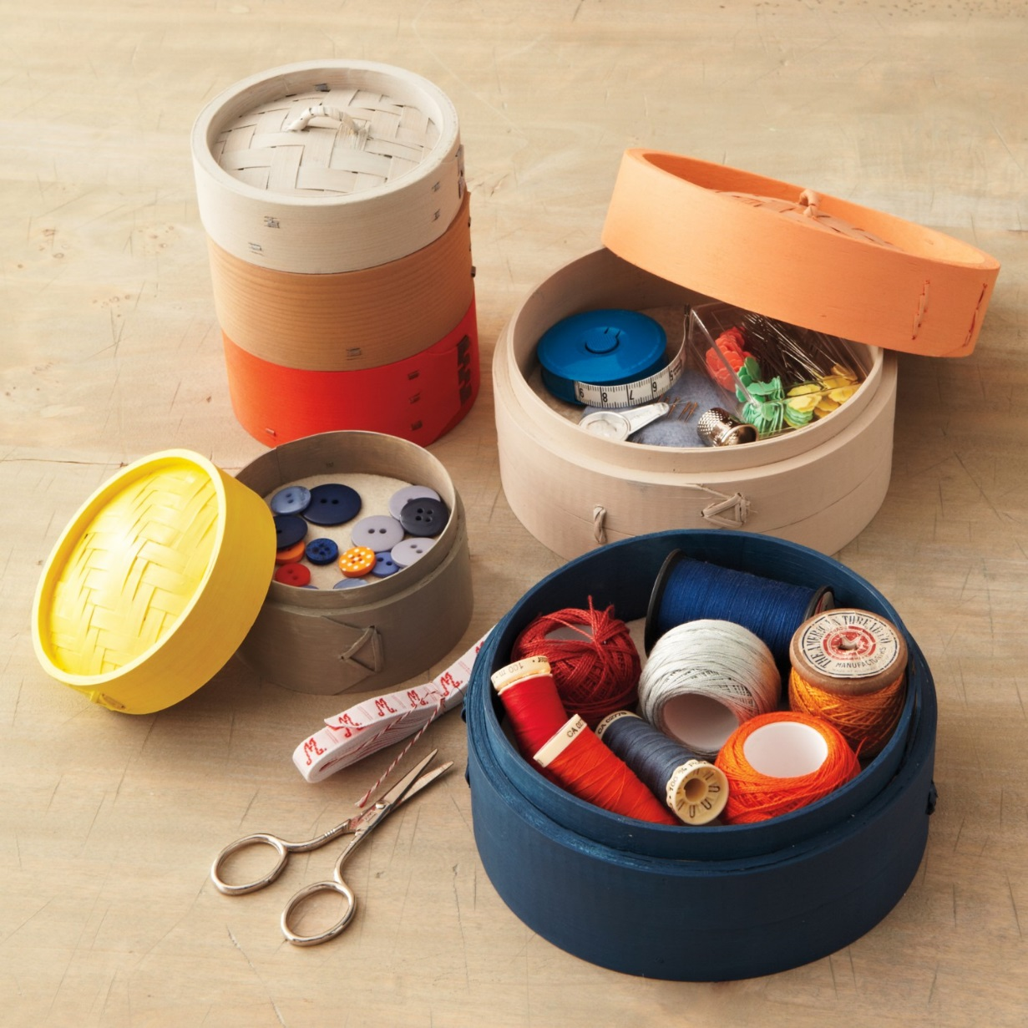
Sewing Supply Name, functions, and descriptions

Slide 2
Why do I need to know the name of those sewing supplies?
- You will sound professional so others know you are taking sewing/textile class
- The teacher will understand what you are talking about
- It demonstrates your knowledge so your teacher will know you know
- Because that is their names, call them by their names!!!

Slide 3
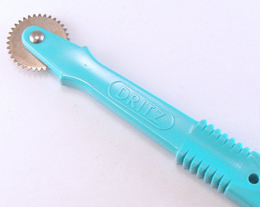
Function= How it is being used
Name: tracing wheel
Function: Used with dressmaker’s tracing paper to transfer pattern marking to fabric

Slide 4
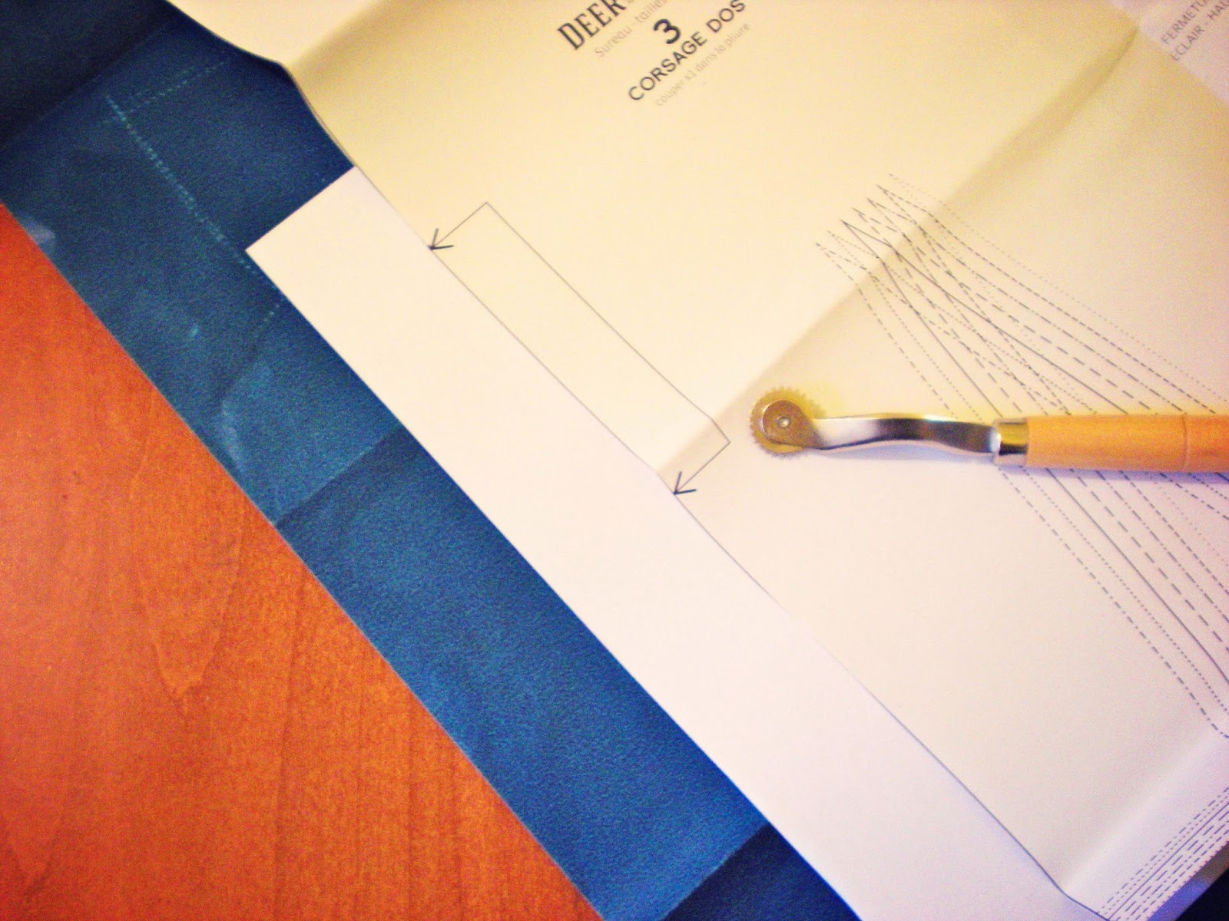

Slide 5
Description= Tell us how the supply looks like
Name: Loop turner
Description: Long wire-like tool with a hook at the end for grasping fabric when turning bias tubing to the right side.

Slide 8
Pick up textbooks and work

Slide 9
Name: Colour ball pins
Function:
Temporarily holds fabric together

Slide 10
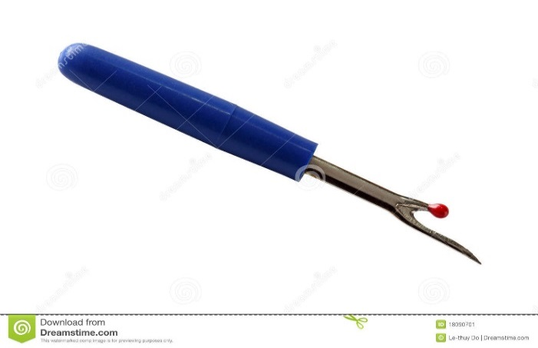
Name: Seam Ripper
Function: Cutting seam open or remove wrong stiches

Slide 11
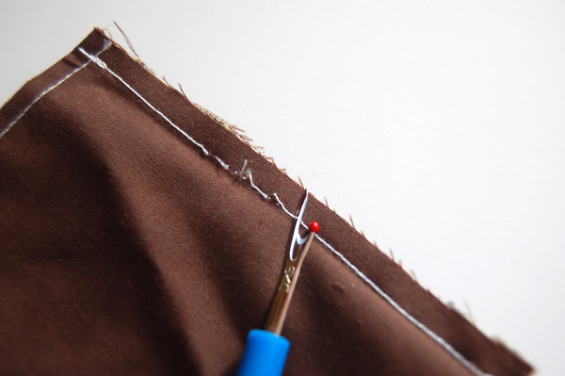

Slide 12
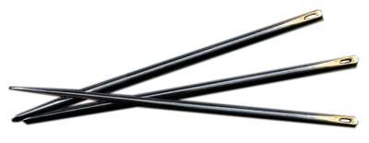
Name: Hand Sewing Needles
Function: General purpose sewing.
Notice “eyes” are at the dull ends….

Slide 13
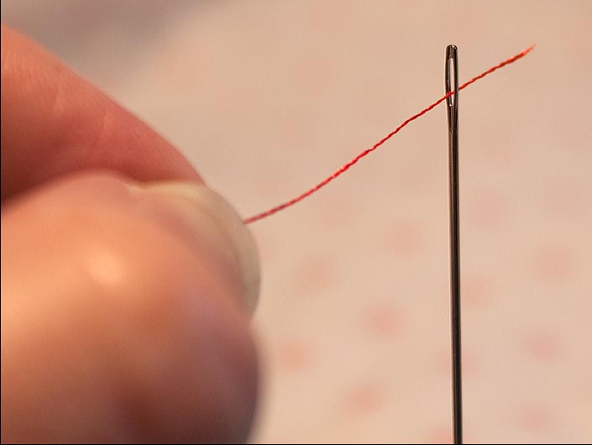
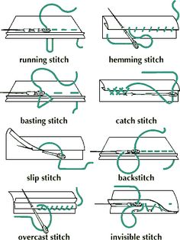
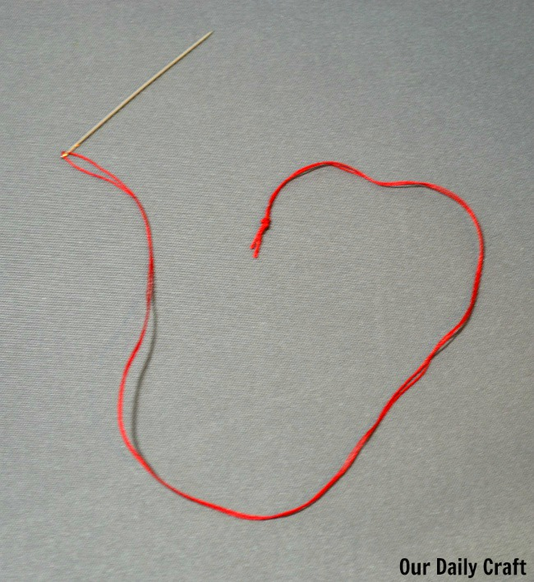

Slide 14
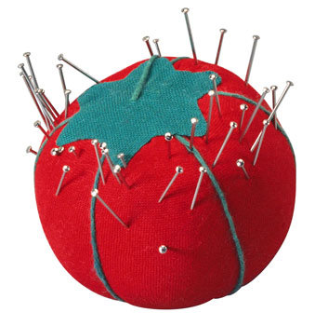
Name: Pin cushion
Function: Storing sharp pins and needs

Slide 15
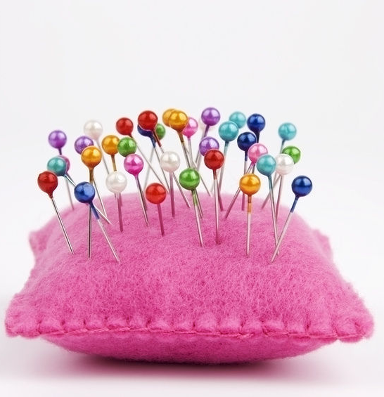
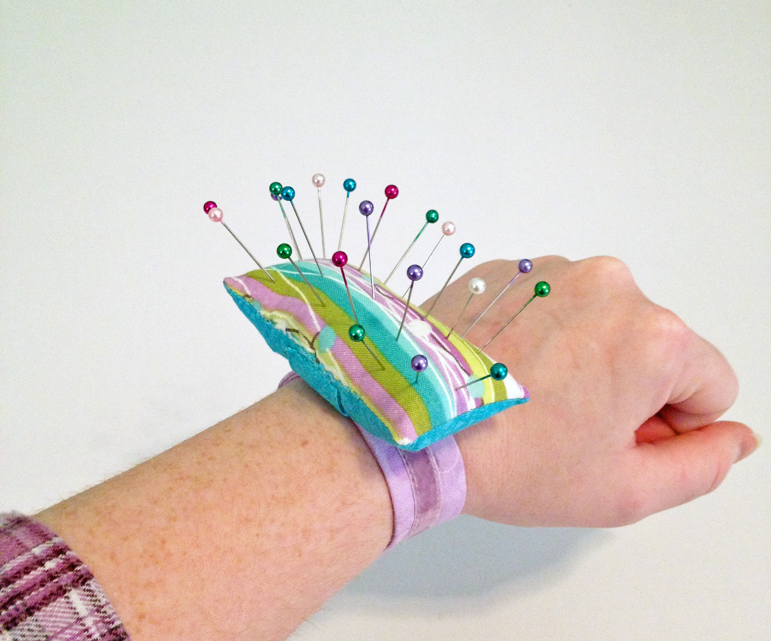
Caution: DO NOT PUT PINS or NEEDLES IN YOUR MOUTH!!!

Slide 16
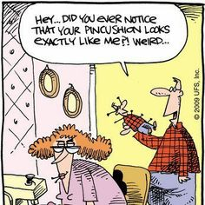

Slide 17
Name: Needle Threader
Function: Makes threading needle easy

Slide 18
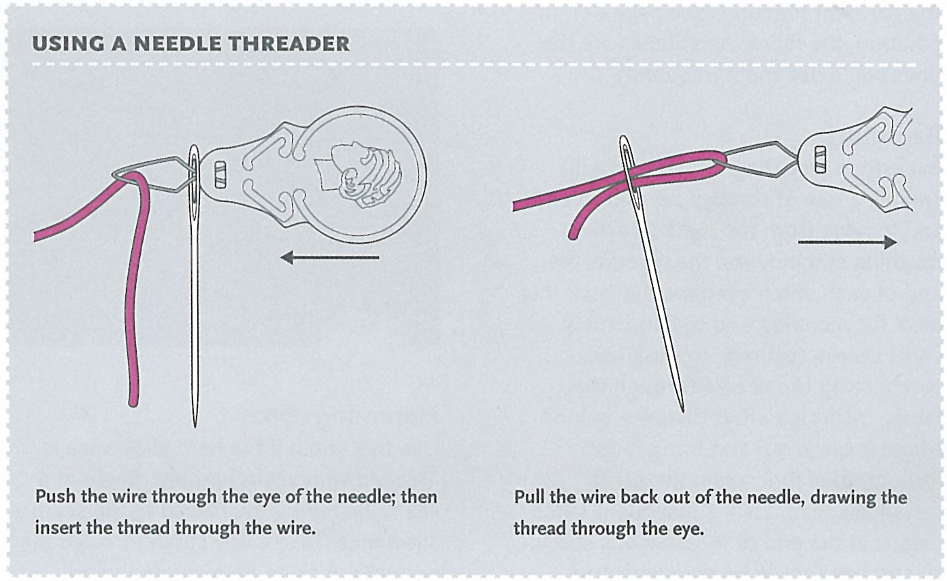

Slide 19
Name: Sewing Gauge
Function: Ruler to measure desired measurement

Slide 20
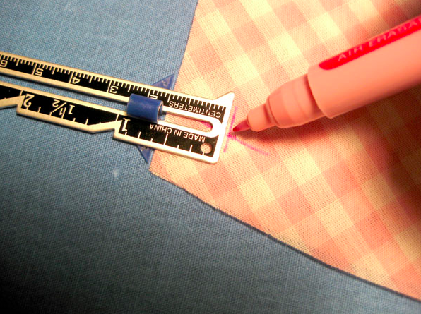

Slide 21
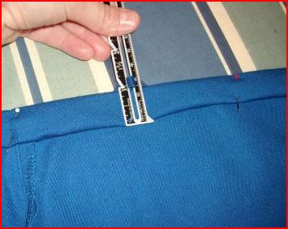

Slide 22
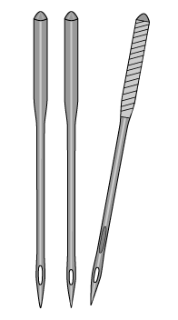
Name: Sewing Mchine Needle
Function: Sewing by using the machine

Slide 23
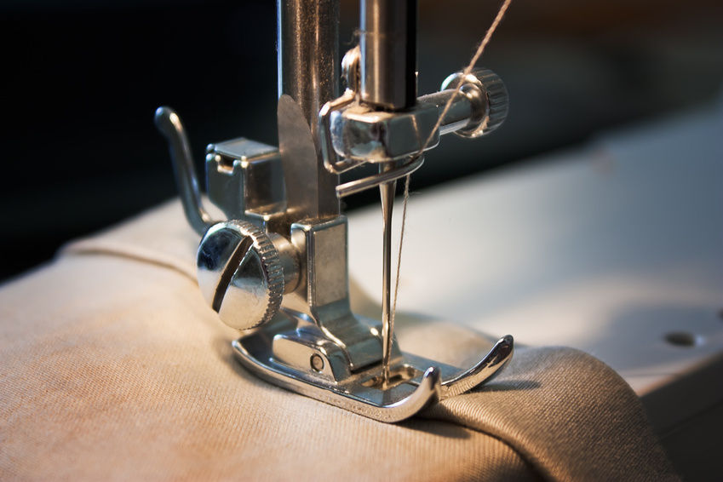

Slide 24
Name: Embroidery Floss
Description: Thick strands of thread for colouring effects

Slide 25
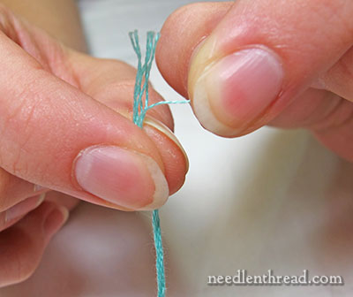
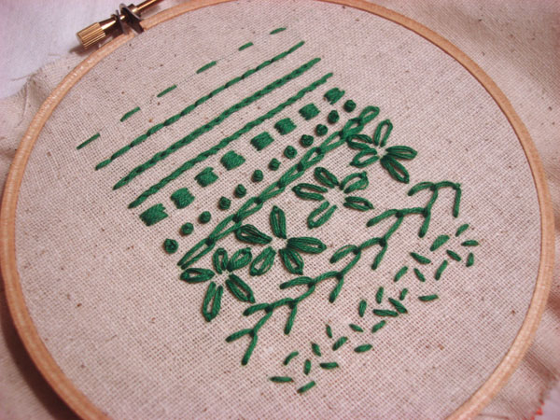

Slide 26
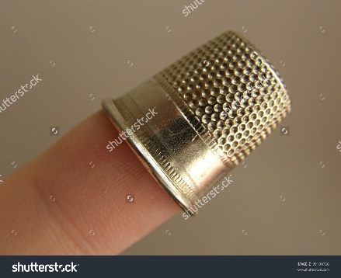
Name: Thimble
Function: Protect finger when sewing.
Helps push needle through thick fabric.

Slide 27
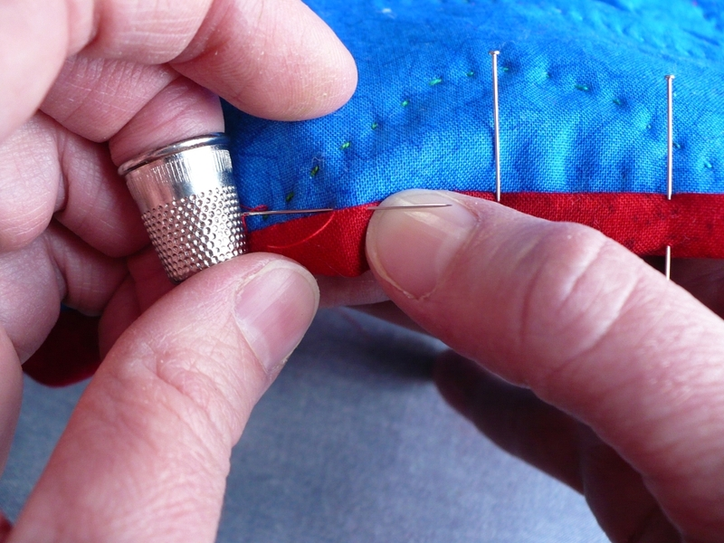

Slide 28
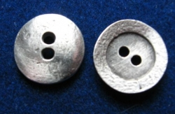
Name: Sew through buttons
Description: Plastic or metal pieces with holes (2-4)

Slide 29
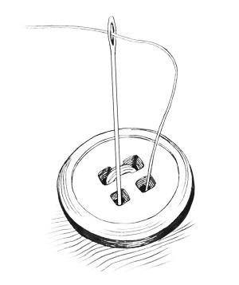

Slide 30
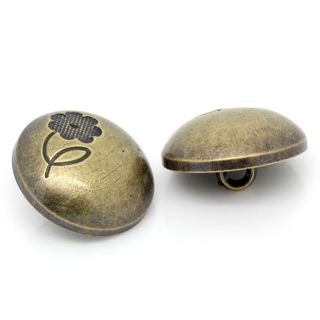
Name: Shank buttons
Description: Button with a solid top and 1 opening area to sew at the bottom

Slide 31
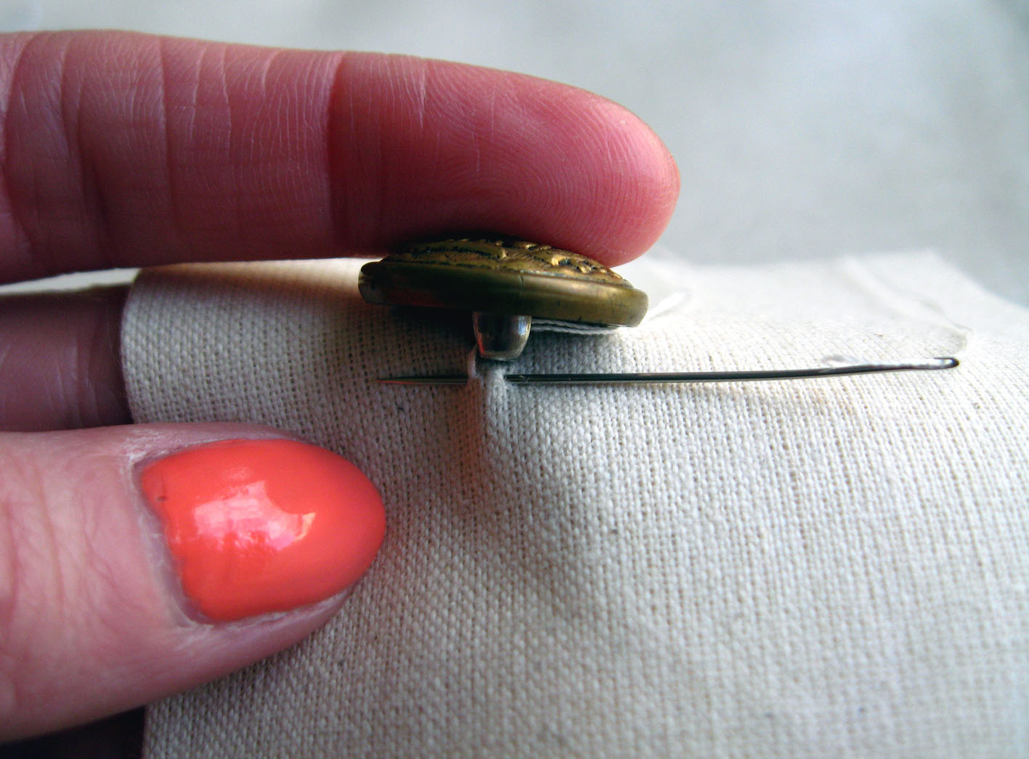

Slide 32
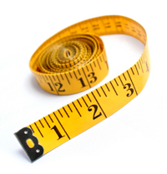
Name: Tape Measure
Function: Flexible tape for taking body measurements

Slide 33
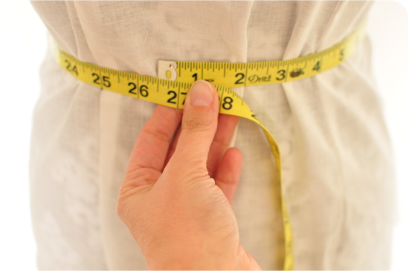

Slide 34
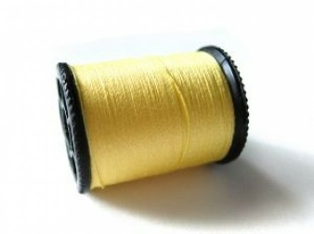
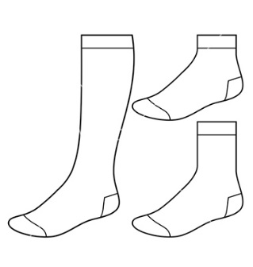
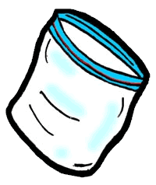
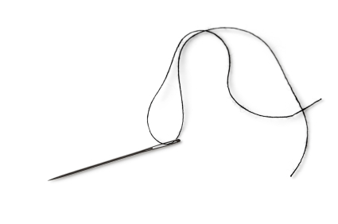
Reminder: Sewing items deadline approaching April. 12-13
Thread. Colour match to socks
A pair of crew socks
A container to keep
Supplies in
Hand sewing needle

Slide 35
Intro-Test Forecast… Apr. 18-19
Closed book
- Names and Functions of sewing notions
- Coding and Decoding laundry symbols
- Identify different stitching types
- Safety and techniques of hand sewing

Slide 36
Make a name label
Use small note paper
Criteria:
- Easy to recognize your name
- Well use of sewing supplies as part of your
design
- Shows personality and creativity

